Slide 1

Geometry
Unit 11, Lesson 2 Constructing the Incenter of a Triangle Volume 2, pg. 182

Slide 2


Benchmark
MA.912.GR.5.3
Construct the inscribed and circumscribed circles of a triangle.
volume 2, pg. 182

Slide 3
Integrated Mathematical Thinking and Reasoning Standards
MA.K12.MTR.1.1 Actively participate in effortful learning both individually and collectively.
MA.K12.MTR.2.1 Demonstrate understanding by representing problems in multiple ways.
MA.K12.MTR.4.1 Engage in discussions that reflect on the mathematical thinking of self and others.
MA.K12.MTR.5.1 Use patterns and structure to help understand and connect mathematical concepts.
MA.K12.MTR.6.1 Assess the reasonableness of solutions.
volume 2, pg. 182

Slide 4

Learning Targets
I can construct an inscribed circle in a triangle.
I can locate the incenter of a triangle.
volume 2, pg. 182

Slide 5

Warm-Up
volume 2, pg. 182

Slide 6
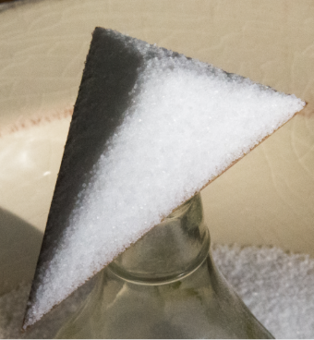
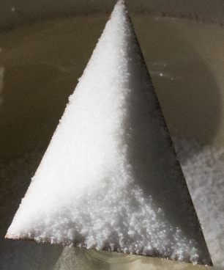
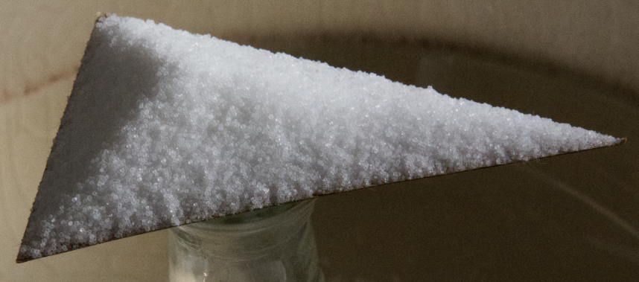
11.2.1 Warm-Up: Salt Pile
volume 2, pg. 182

Slide 7
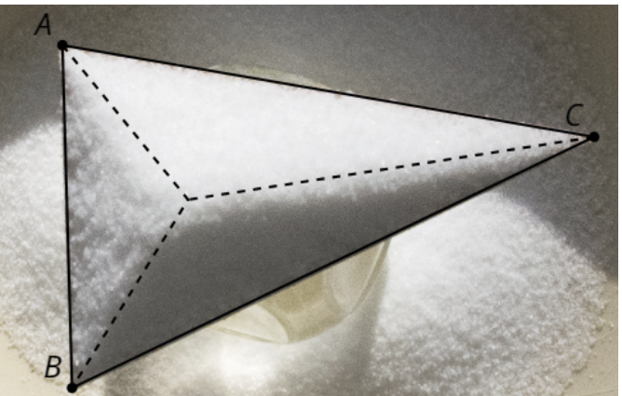
Salt is poured onto a triangle until it piles up. As the salt piles up, the pile reaches a maximum height. As the salt reaches a maximum height, new grains of salt fall off whichever side of the triangle is closest.
What do you wonder about the salt pile?
volume 2, pg. 182

Slide 8
What do you notice about the salt pile?
What do you notice about the point where the salt reaches a maximum?
volume 2, pg. 182

Slide 9

Exploration
volume 2, pg. 183

Slide 10

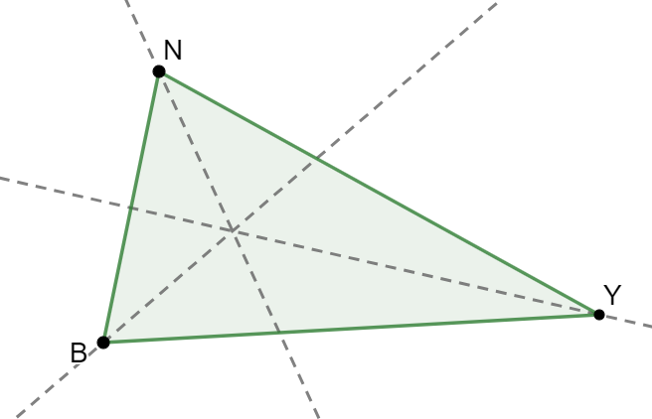
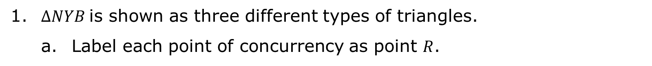
11.2.2 Exploration: Constructing an Inscribed Circle
1. $∆NYB$ is shown as three different types of triangles.
Label each point of concurrency as point $R$.
Acute
volume 2, pg. 183

Slide 11
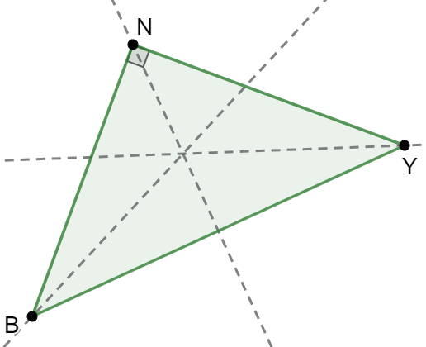
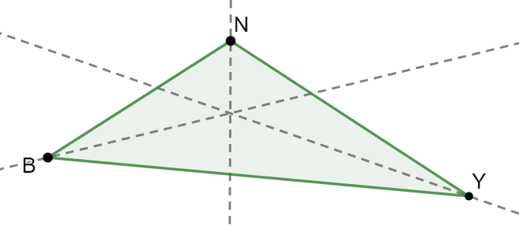
Right
Obtuse
volume 2, pg. 183

Slide 12
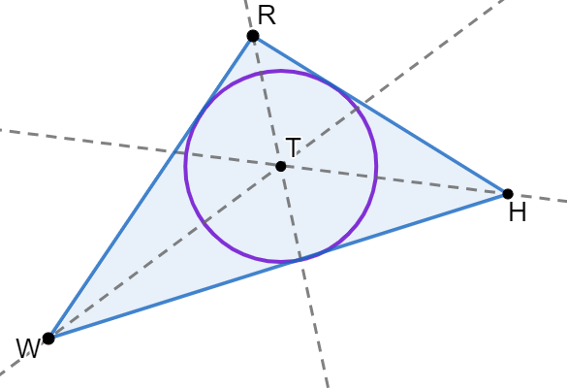
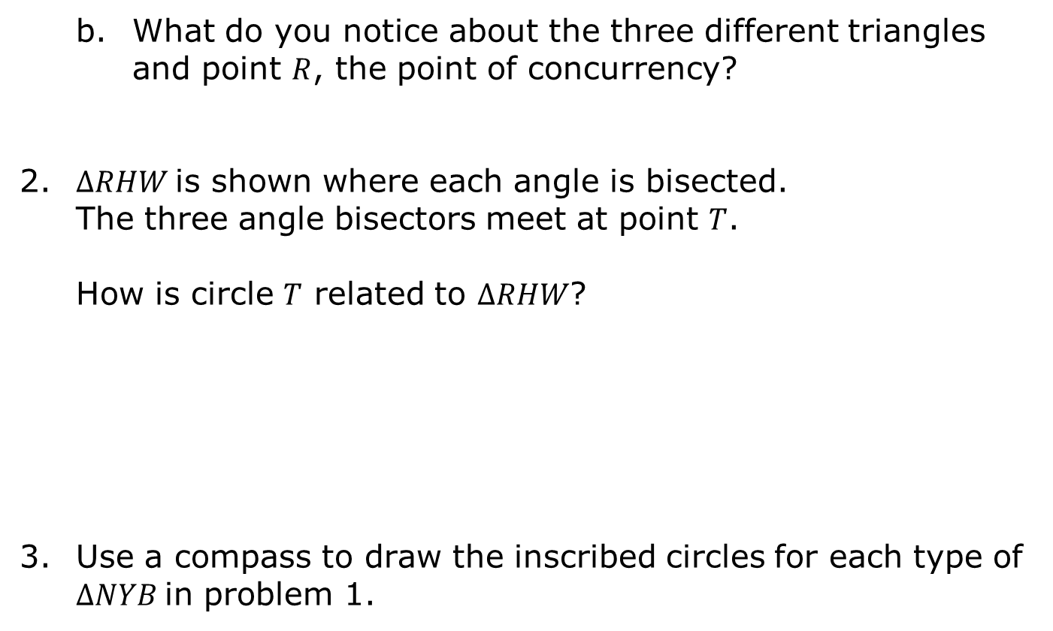
What do you notice about the three different triangles and point $R$, the point of concurrency?
2. $∆RHW$ is shown where each angle is bisected. The three angle bisectors meet at point $T$.
How is circle $T$ related to $∆RHW$?
Use a compass to draw the inscribed circles for each type of $∆NYB$ in problem 1.
volume 2, pg. 184

Slide 13
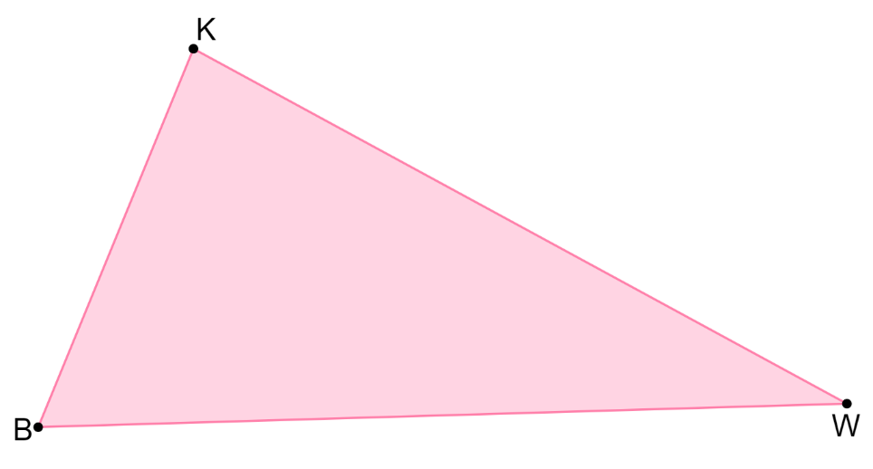
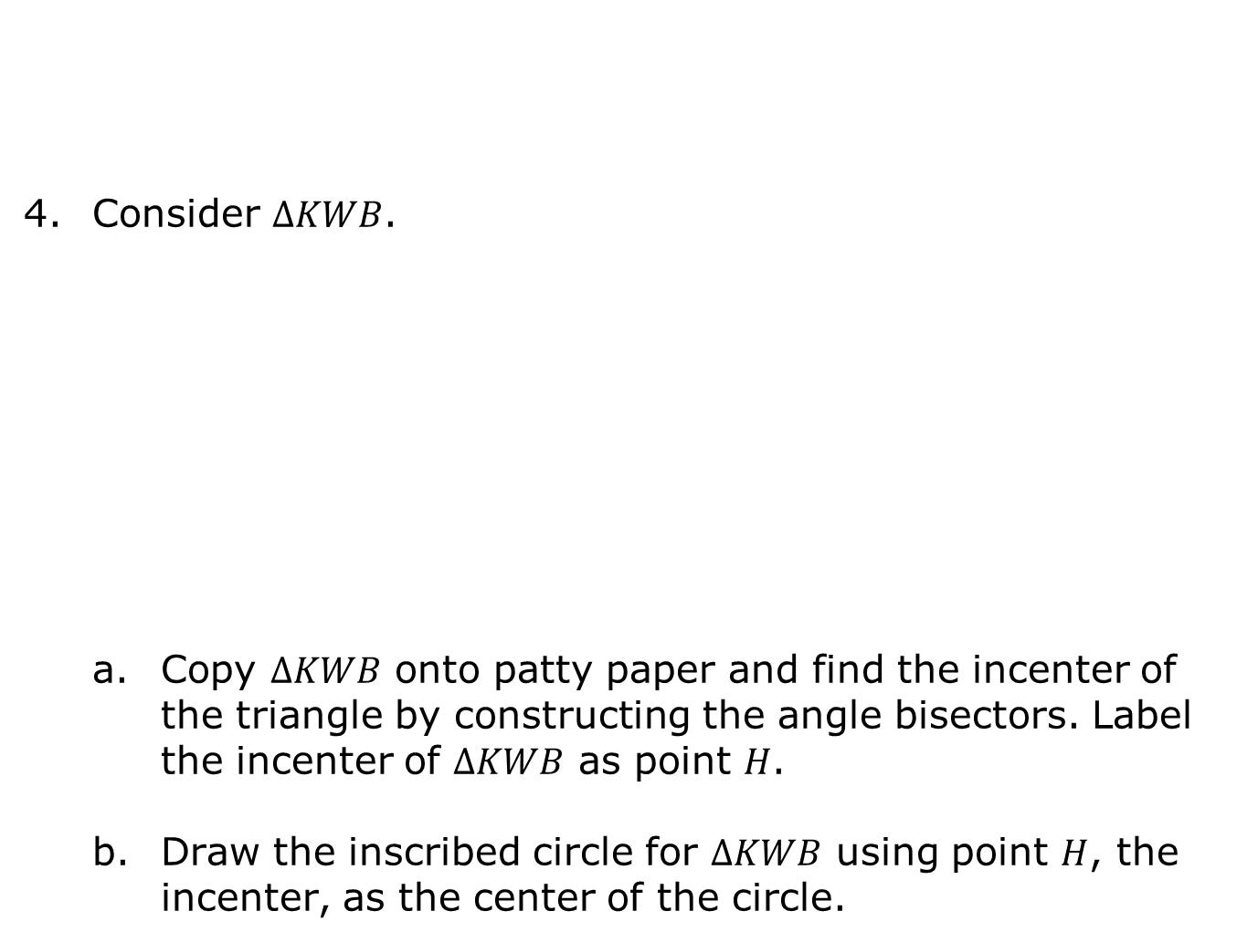
Consider $∆KWB$.
Copy $∆KWB$ onto patty paper and find the incenter of the triangle by constructing the angle bisectors. Label the incenter of $∆KWB$ as point $H$.
Draw the inscribed circle for $∆KWB$ using point $H$, the incenter, as the center of the circle.
The point of concurrency of the angle bisectors of a triangle is the incenter.
volume 2, pg. 184

Slide 14
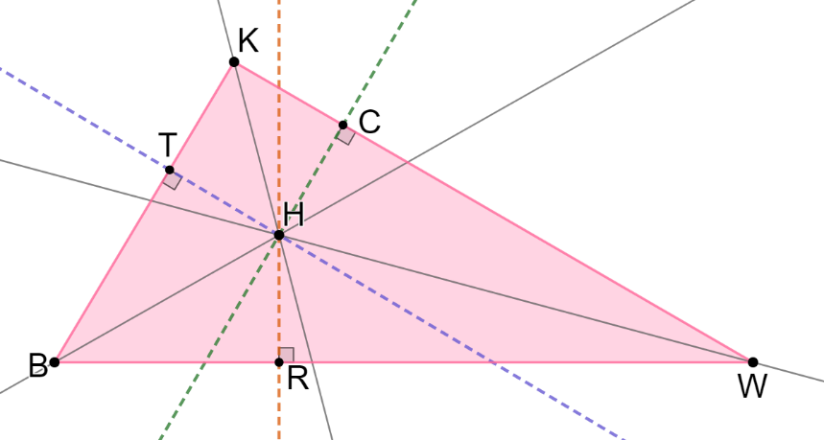

Noah is concerned that when he draws the inscribed circle, he does not have the exact points on the triangle where the circle intersects the triangle. He drew three perpendicular lines from the center to each side.
When Circle $H$ is drawn on Noah’s version of $∆KWB$, what relationship do $\overline{HR}$, $\overline{HT}$, and $\overline{HC}$ have to each other and to Circle $H$?
Draw Circle $H$ that passes through points $T$, $C$, and $R$.
volume 2, pg. 185

Slide 15
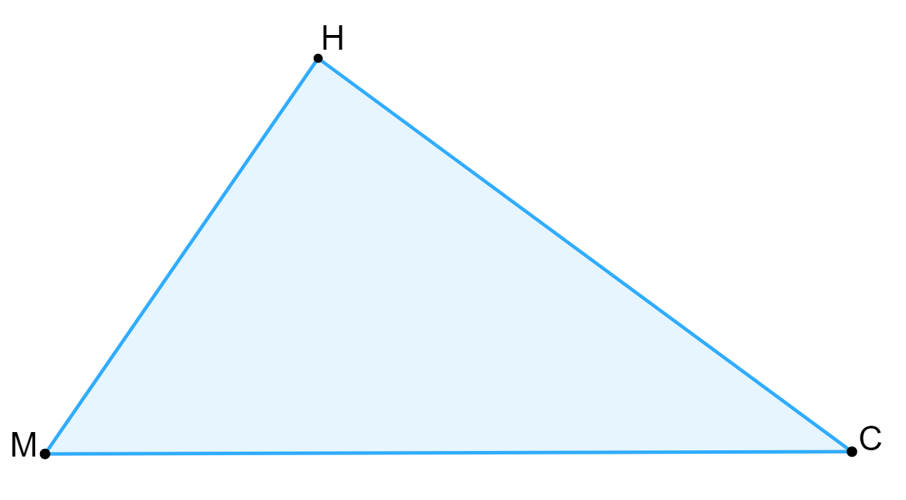
Copy $∆MHC$ onto another piece of paper. Then, use a compass and a straight edge to inscribe a circle in $∆MHC$.
volume 2, pg. 185

Slide 16
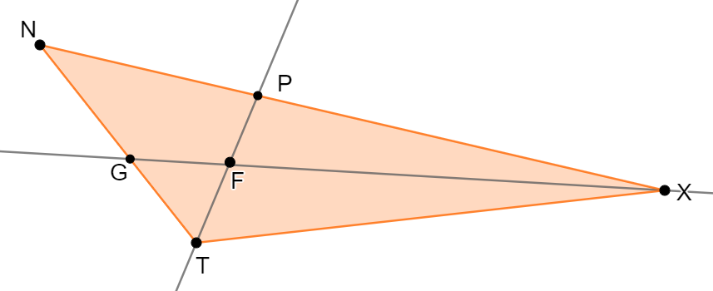

$∆NXT$ is shown where $\overline{PT}$ bisects $∠NTX$ and $\overline{GX}$ bisects $∠PXT$.
Will the inscribed circle of $∆NXT$ pass through points $P$ and $G$?
Justify why $\overline{PF}$ and $\overline{FG}$ are not radii of the inscribed Circle F.
volume 2, pg. 185

Slide 17
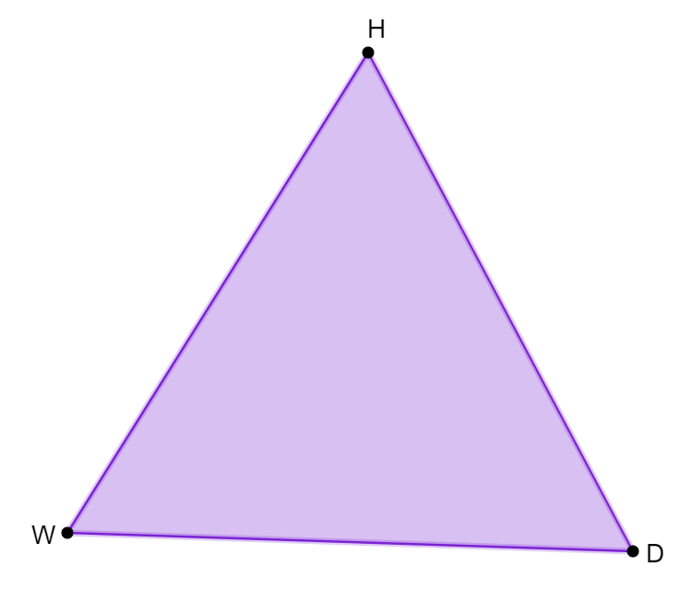
Copy $∆HDW$ onto a piece of patty paper. Then, construct the incenter and circumcenter of $∆HDW$.
volume 2, pg. 186

Slide 18

Wrap-Up
volume 2, pg. 186

Slide 19

11.2.3 Wrap-Up: Reflection
What was the muddiest (most difficult or confusing) point in today’s lesson on constructing a circle inscribed in a triangle?
volume 2, pg. 186

